Slide 1
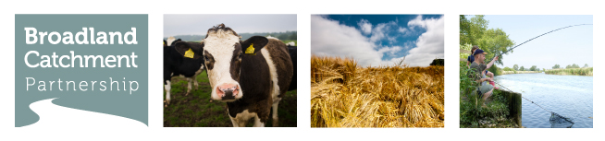



Catchment Plan - Process and Progress
Broads Authority Members Meeting - Friday 17th January 2014
Neil Punchard
Catchment Partnership Officer

Slide 2

The State we’re in!
90% of water bodies fail to achieve European requirements
for WFD Good Ecological Status (105 of 117)
Protected wildlife habitats, such as the River Wensum, are not in favourable condition
Raw drinking water sometimes exceeds precautionary standards for nitrate and pesticides
Lack of water availability at times of low flow for farming, wildlife and public supply
Recent flooding of property and farmland due to heavy rainfall

Slide 3
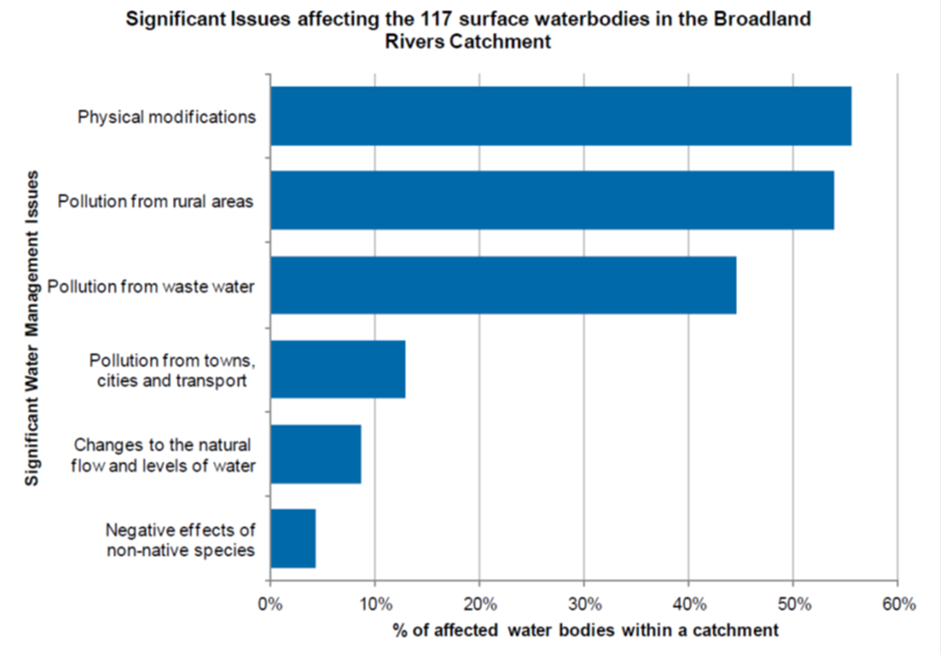
EA Consultation: Challenges and Choices
Environment Agency data (2013)

Slide 4
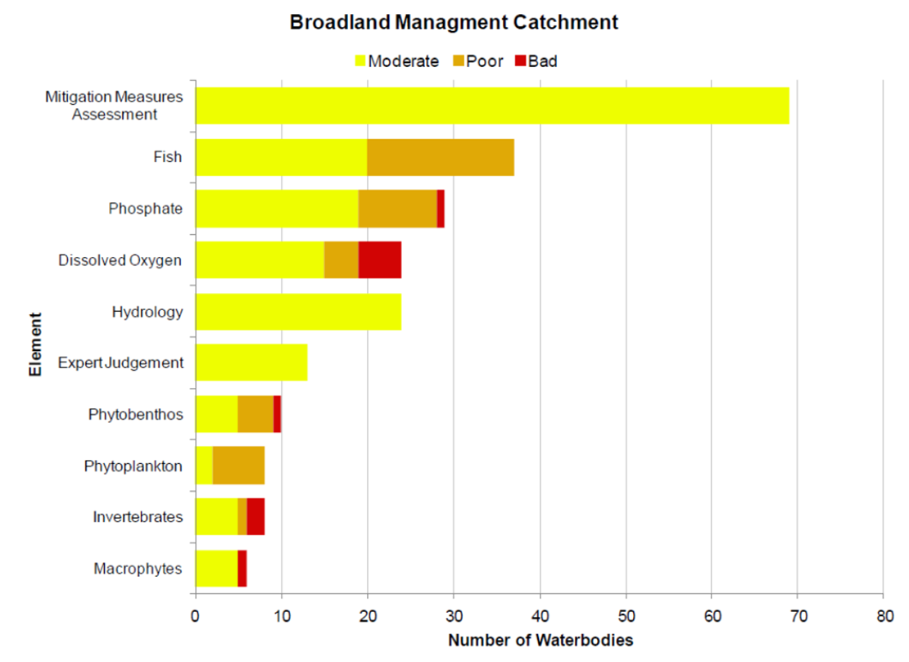
Reasons for WFD Failure: Waterbodies
Environment Agency data (2013)

Slide 5
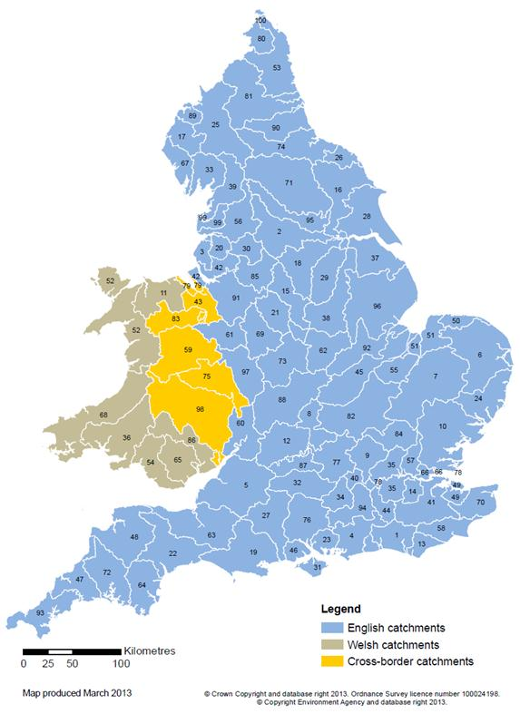
National Roll Out in 2013
Catchment
Based
Approach
Defra aims:
Improvements to the water environment
Defra objectives:
To ensure local knowledge is used to drive local change through:
•agreeing and understanding issues within the catchment
•involving local groups in decision making
•sharing evidence and identifying priorities for action
•seeking to deliver local integrated actions in cost-effective ways that protect local resources.
Environment Agency data (2014)
Notes:
Why did it come about? Improved collaboration and information sharing to reduce contradiction or replication and increase efficiencies. Lots of organisations undertaking different types of often inter-related activity.

Slide 6
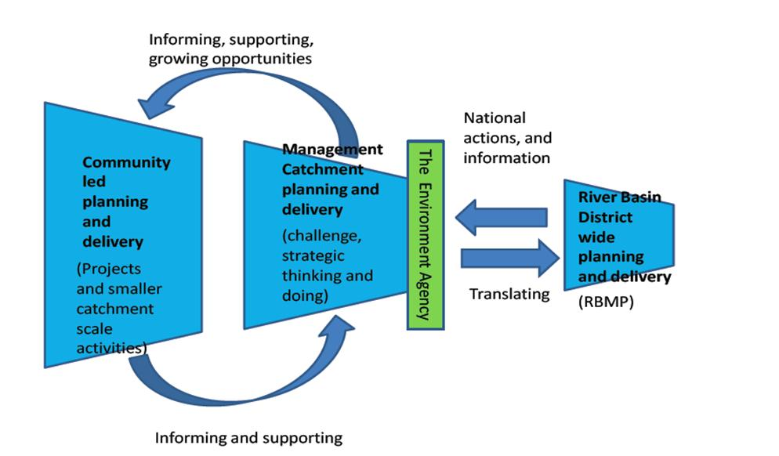
River Basin Management Planning
Source: Nick Hopwood, Defra/EA (2013)

Slide 7
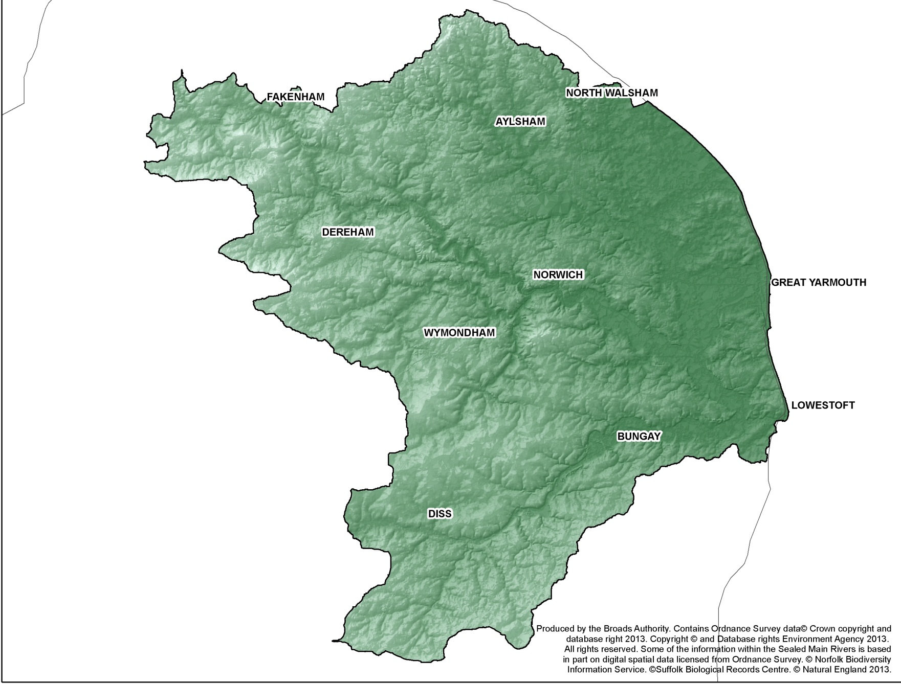
Catchment Background
Catchment area: 3200km²
Land use: >80% arable
mainly privately owned.
Population: around 850,000 residents
Tourism: 7.4 million visitors supporting >6000 jobs, spending £469M in the Broads in 2011¹
Agriculture: 8,500 jobs in the wider Broadland area rely on farming²
Flood risk (properties):
Surface water: 37,991
River: 15,965
Tidal: 46,121³
Water availability (at low flow): None
Sources:
¹STEAM, 2012
²NFU, 2010
³NCC, 2013

Slide 8
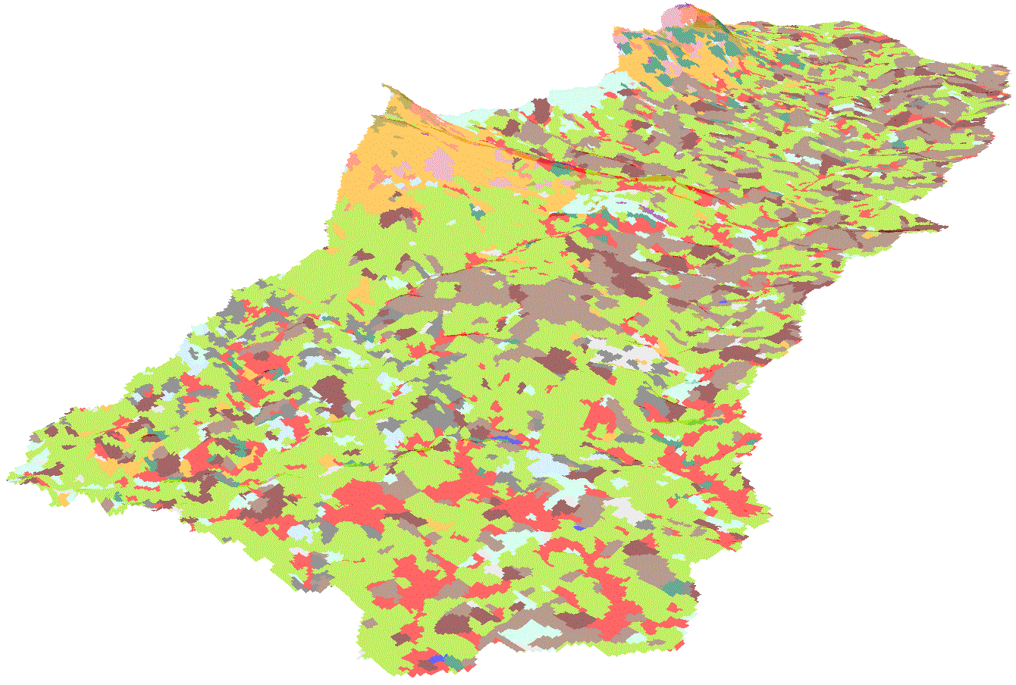
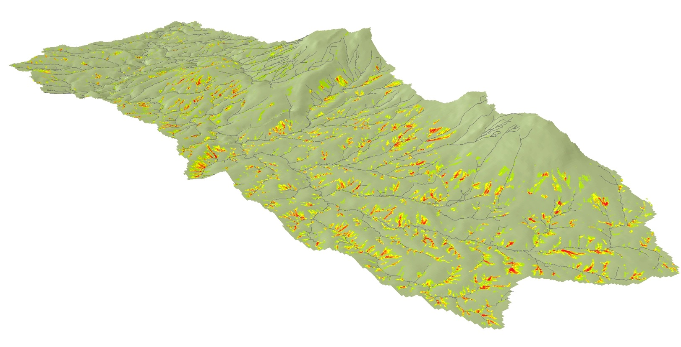
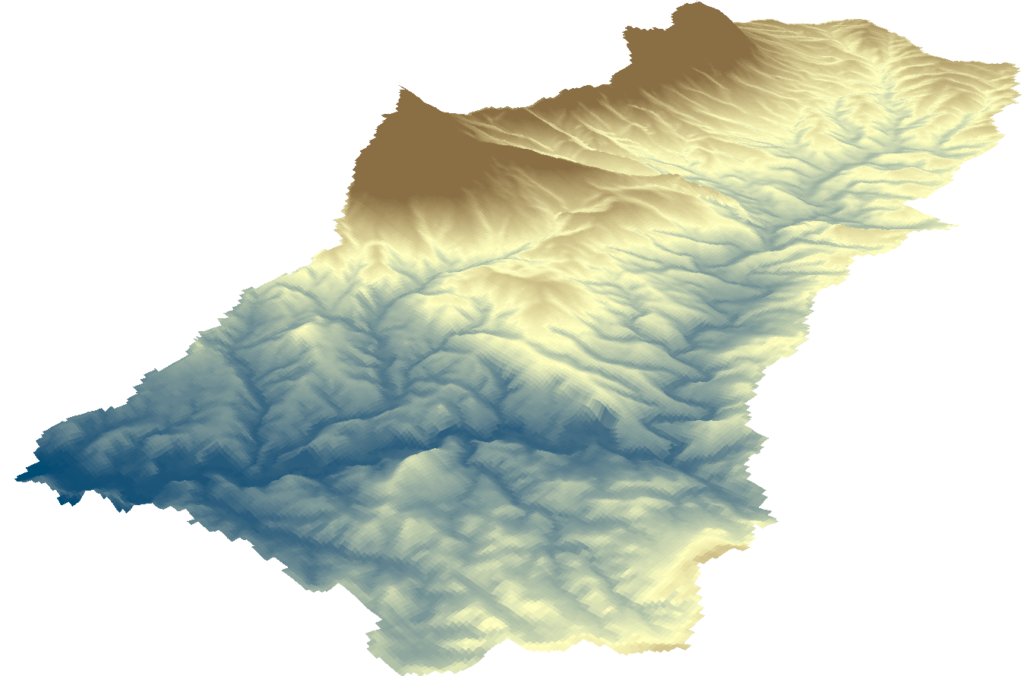
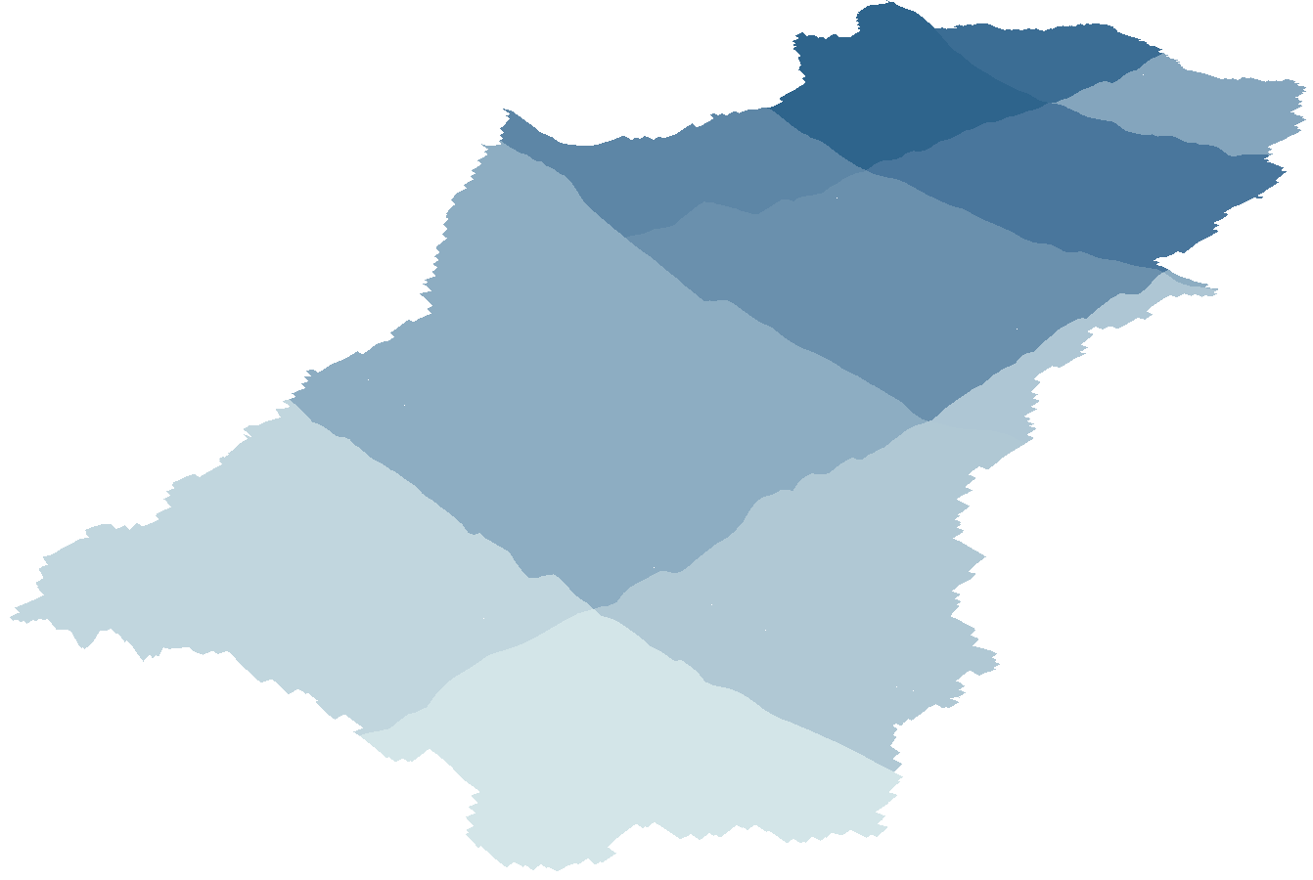
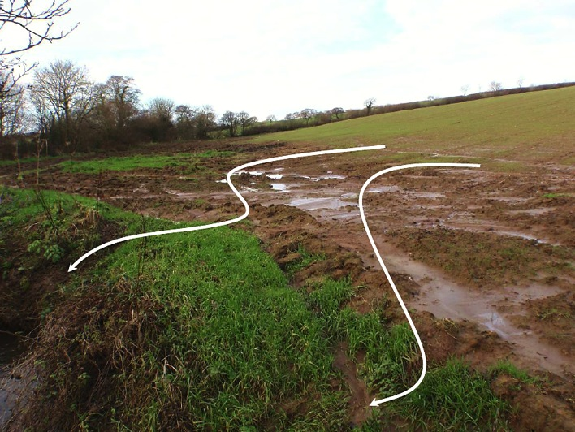
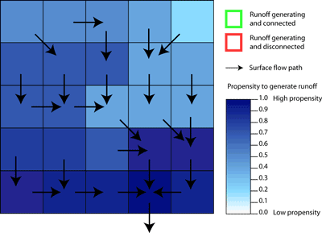
Diffuse Pollution Risk Modelling
Identify and facilitate interventions
Land use
+
Slope
+
Rainfall
Images courtesy of Rivers Trusts (2013)

Slide 9
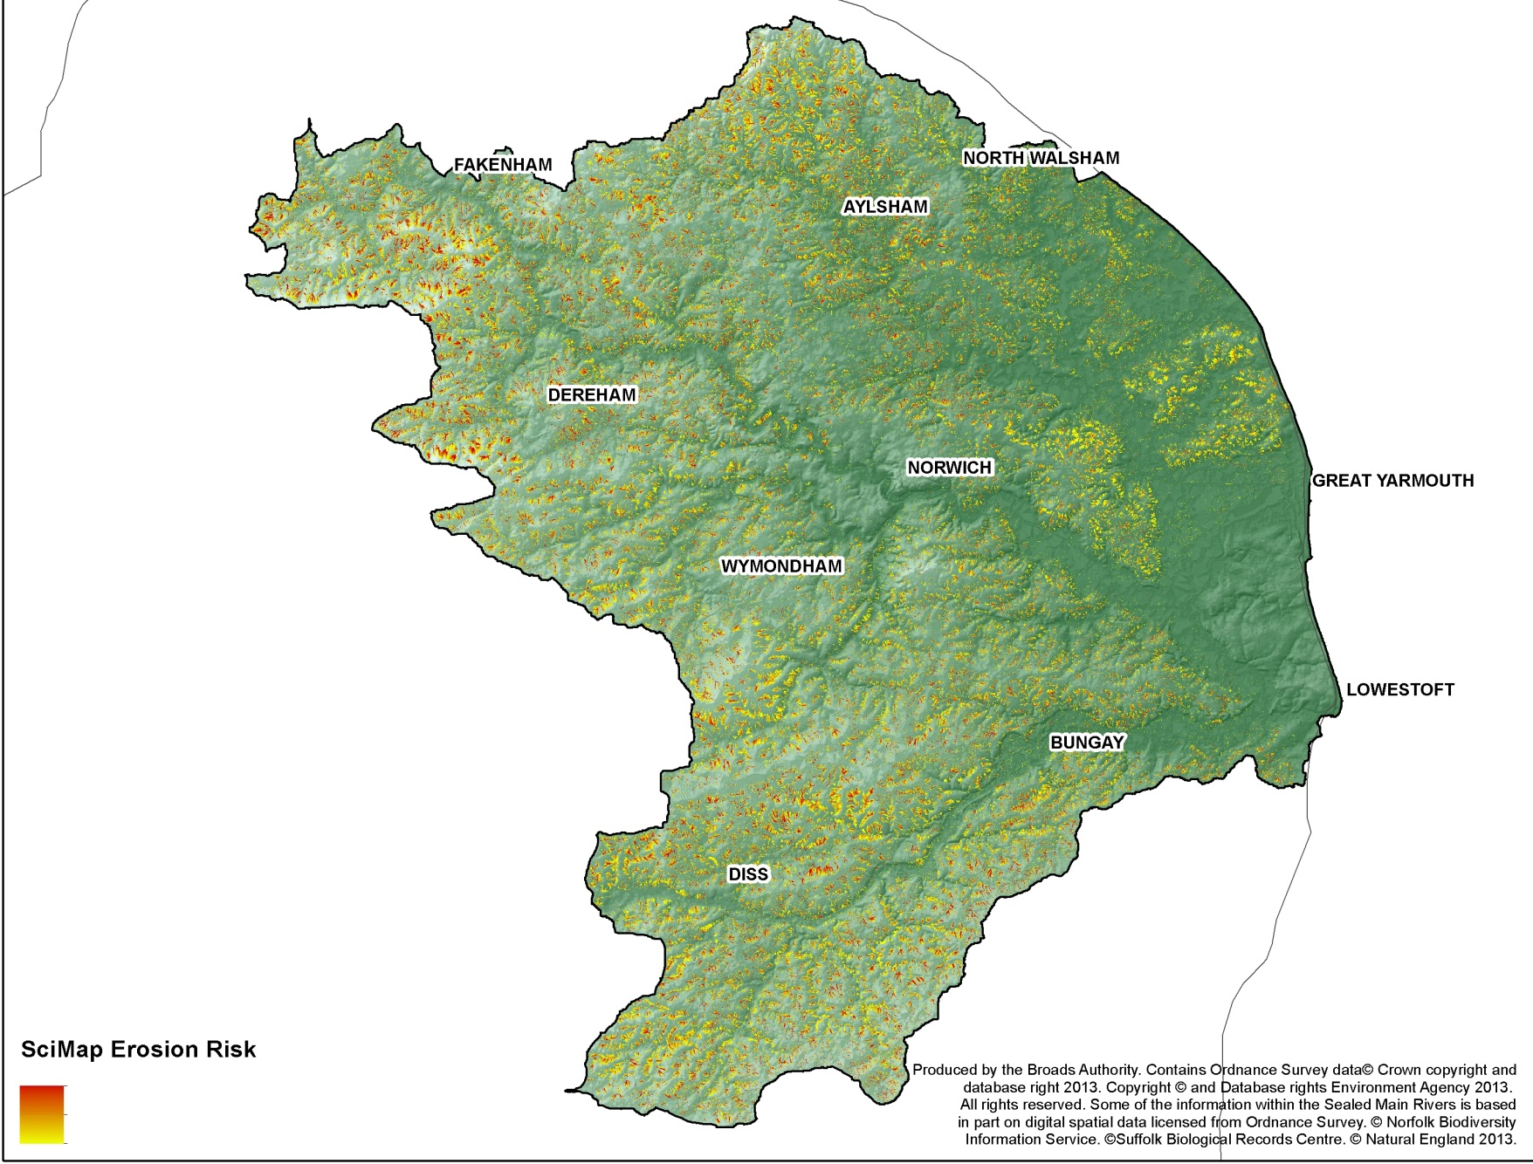
Diffuse Pollution Risk Mapping
Notes:
3200km2, >80% arable land, predominantly privately owned. Red indicates higher ground. Darkest green is at or below sea level

Slide 10
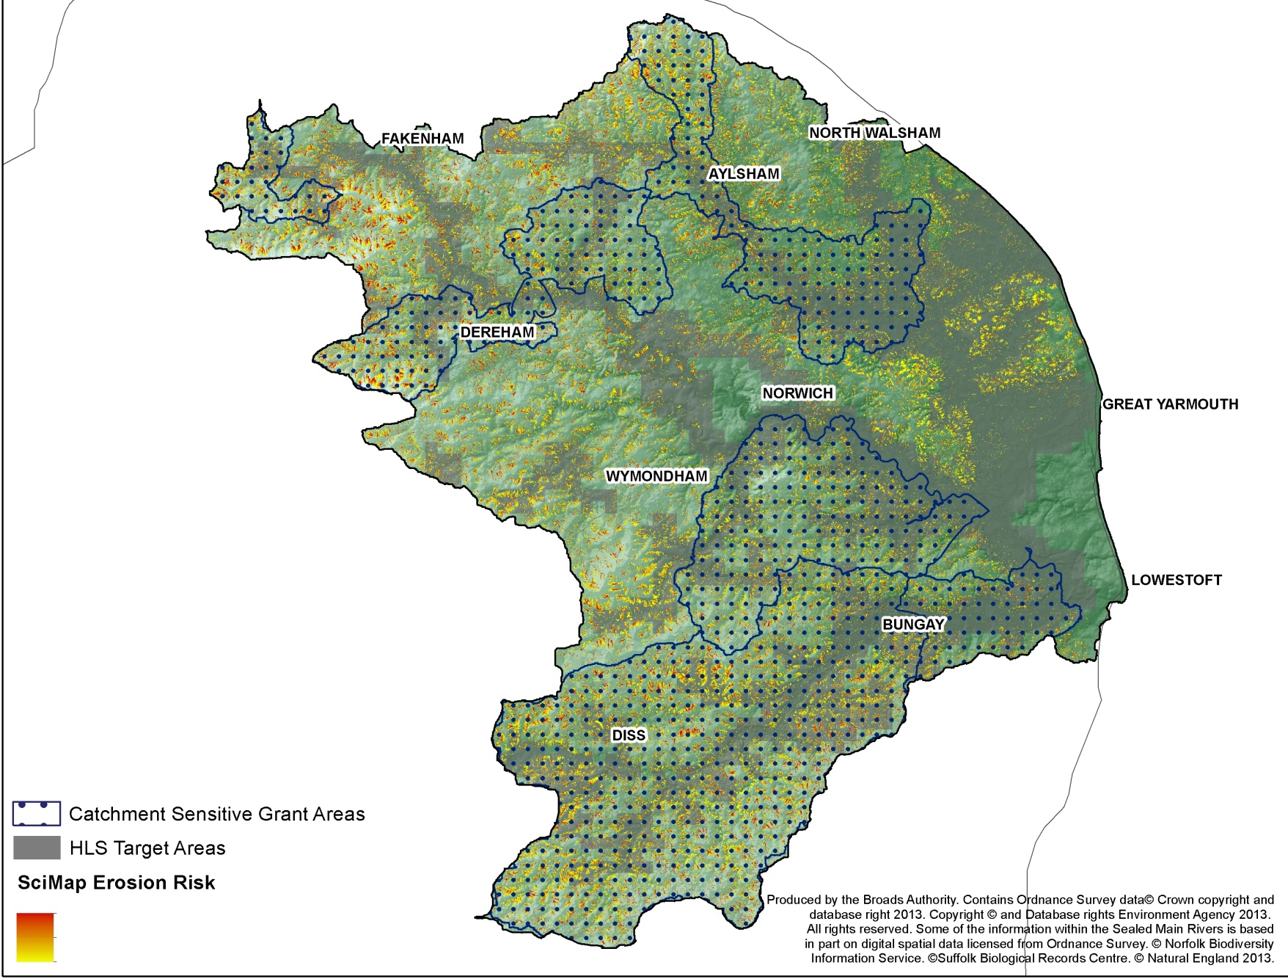

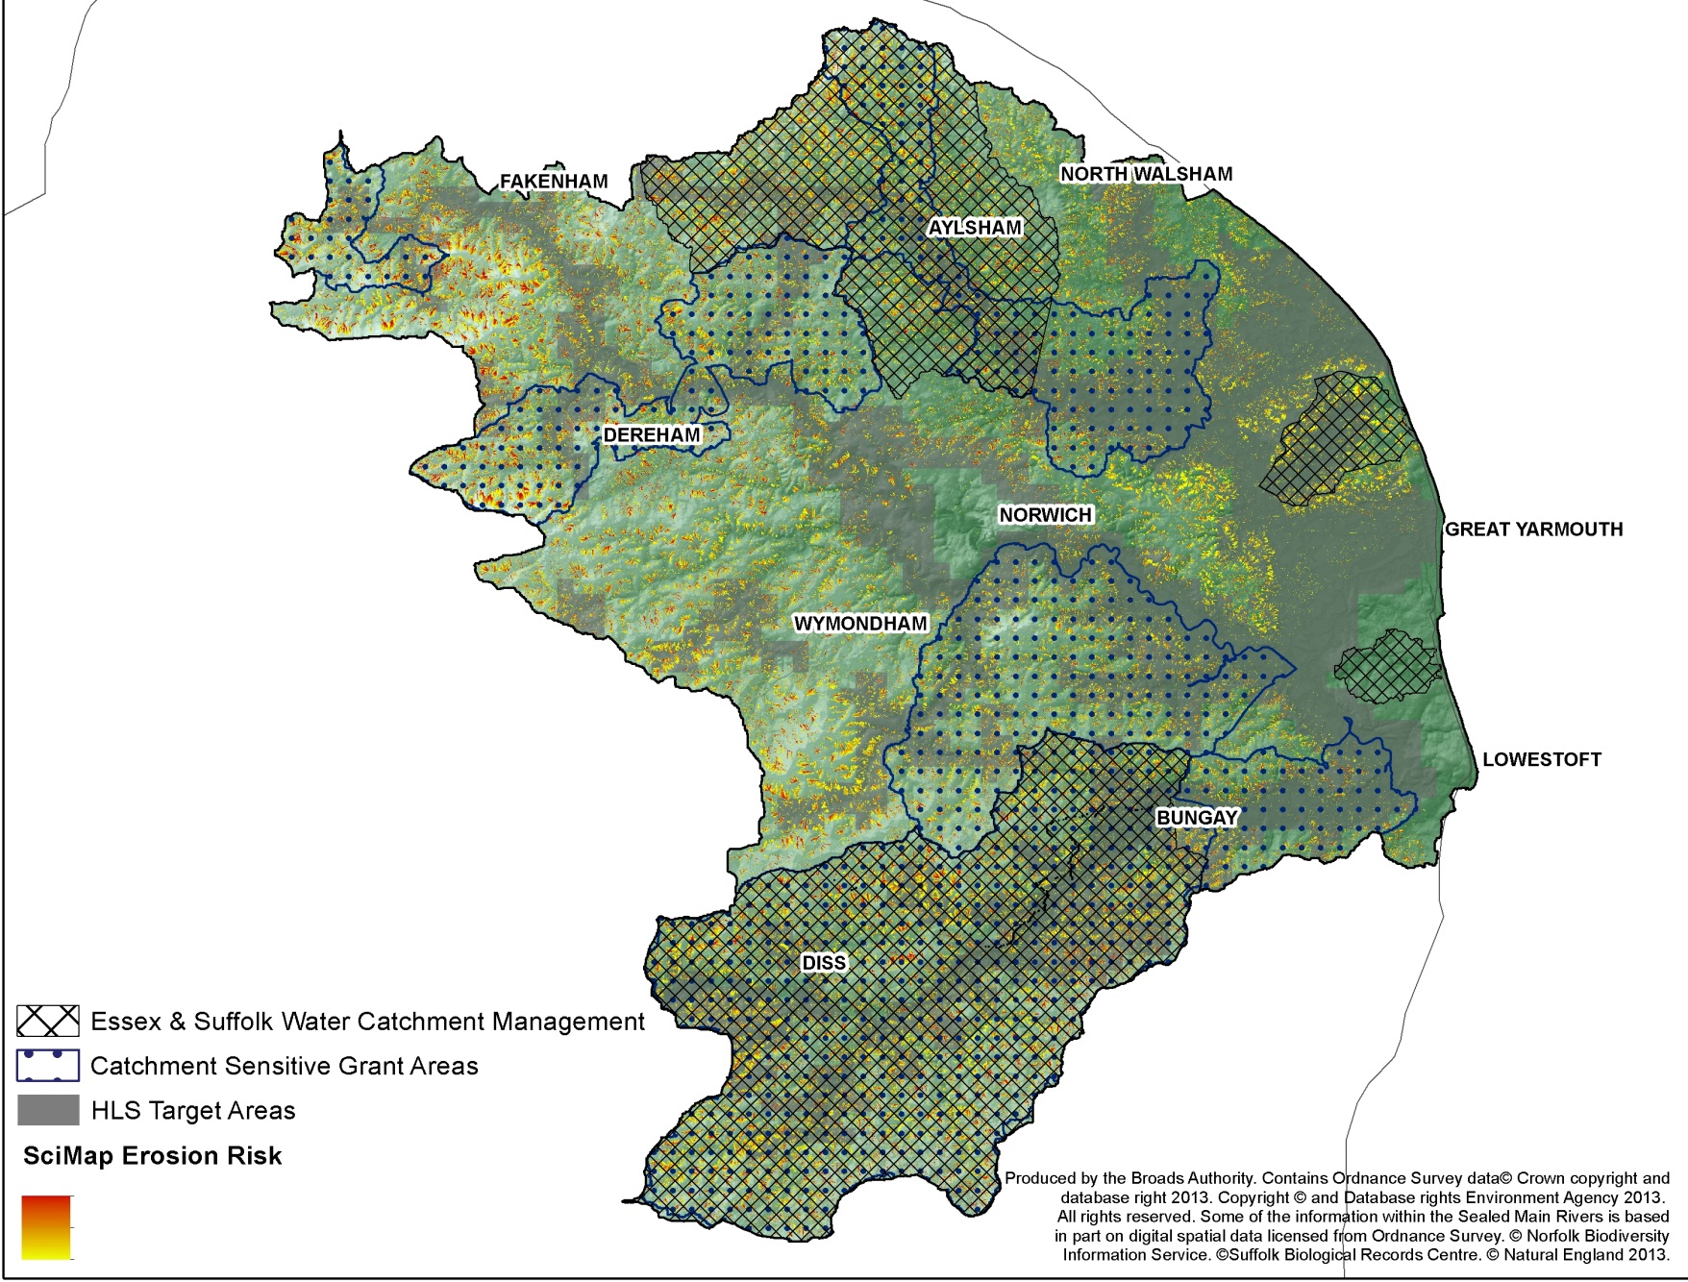

Farming Advice & Grants + Risk
Notes:
Visualisation tool - improves engagement, assists spatial planning, stimulates discussion

Slide 11
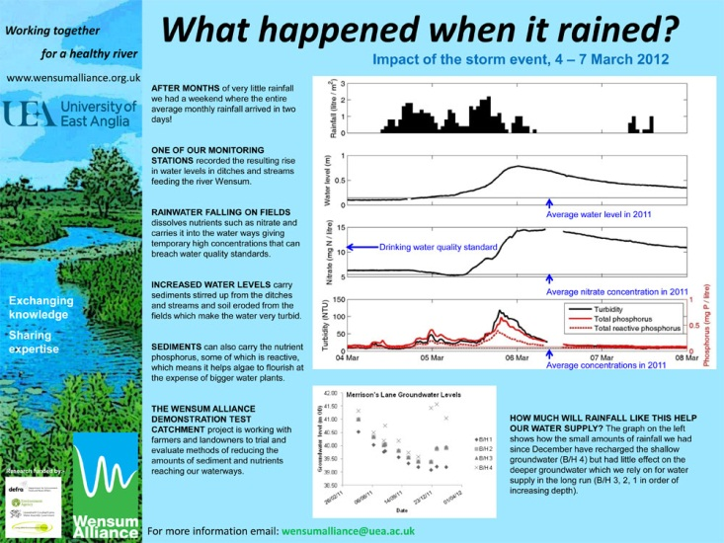
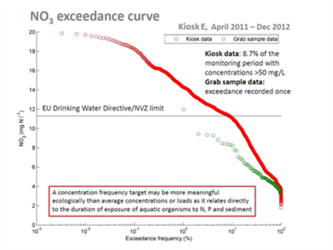
Case Studies and Links: Wensum DTC

Slide 12
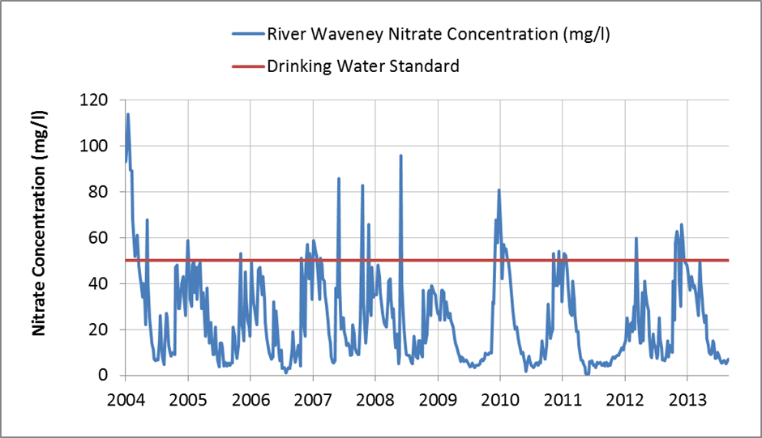
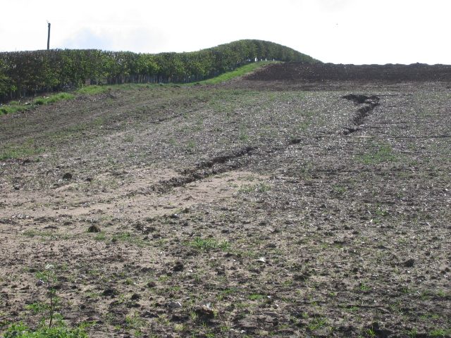
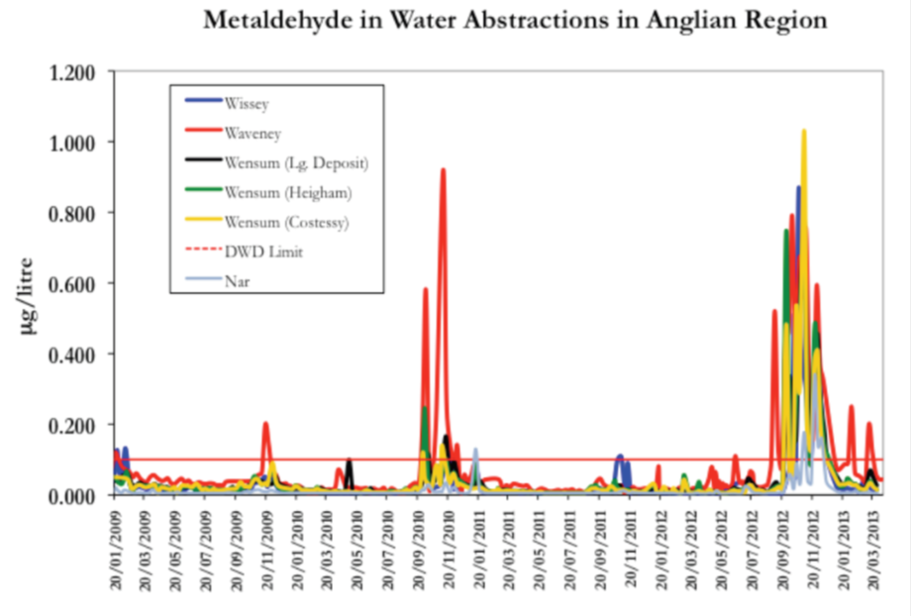
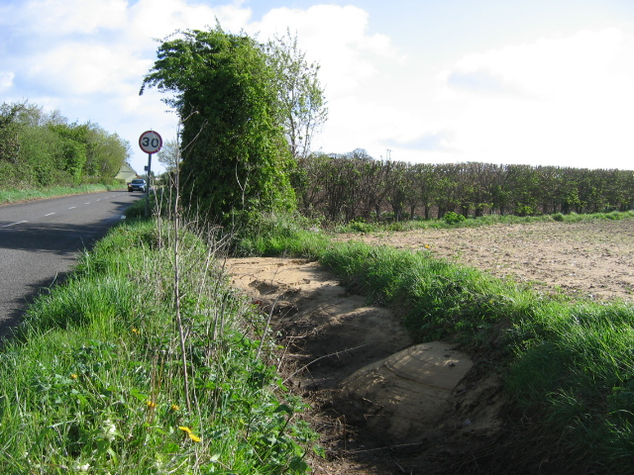
Intermittent High Concentrations
Essex & Suffolk Water data (2013)
Anglian Water data (2013)
Wensum DTC data (2013)

Slide 13
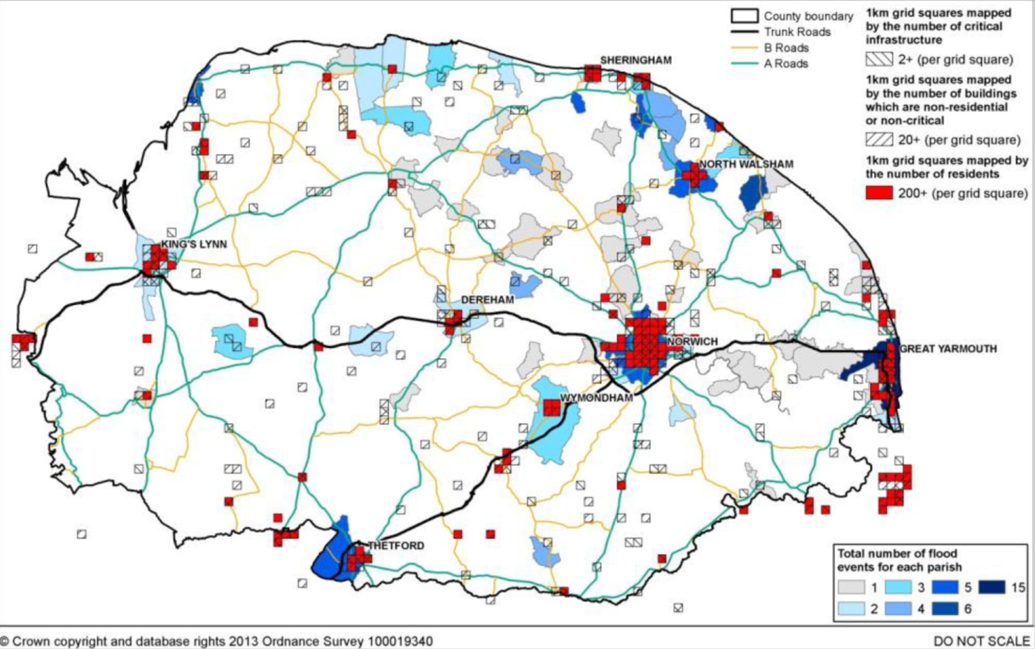
Norfolk Flood Incidents
Courtesy of Norfolk County Council 2013

Slide 14
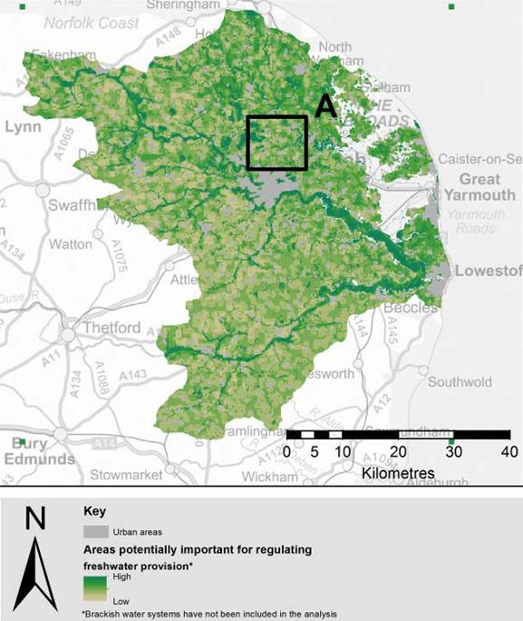
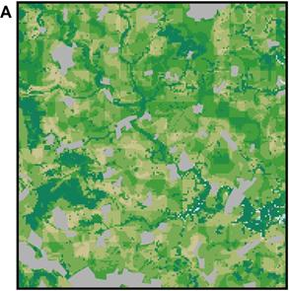
Ecosystem Services: Water Regulation
“Slow the flow”
Reduce peak flows
Increase base flows
“The partnership has a fantastic opportunity to influence the ecological focus areas to include rural SUDS. More power + influence of whole partnership.” Lisa Turner, EA
Courtesy of JNCC (2013)

Slide 15
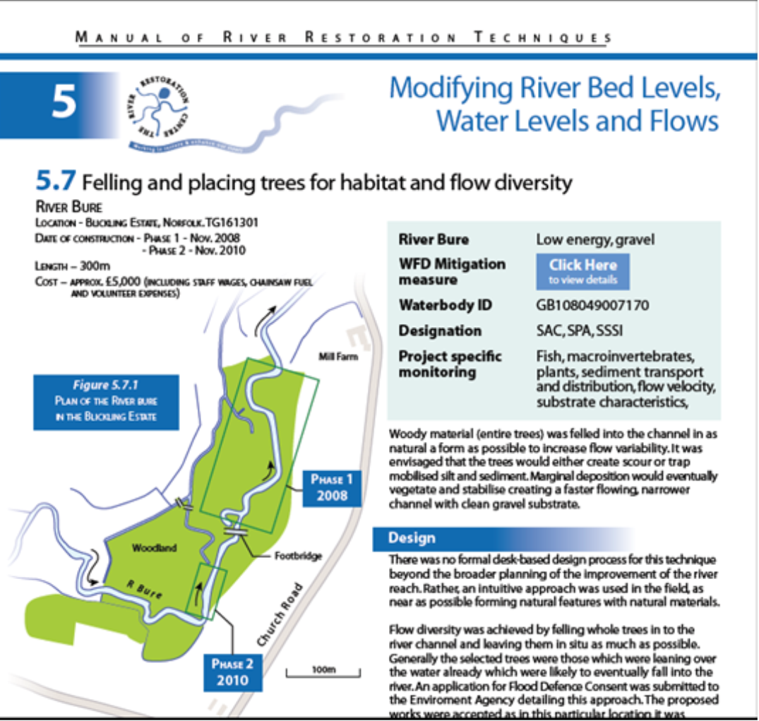
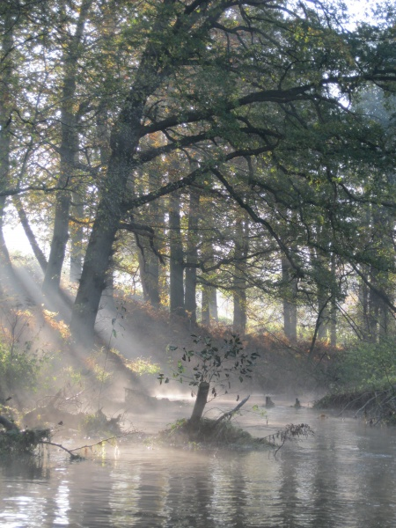
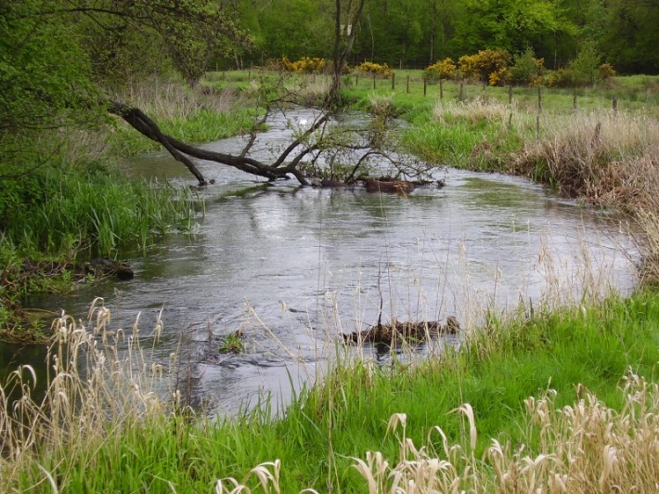
River Restoration: Case Studies and Links
River Restoration Centre (2013)

Slide 16
Timeline and Milestones - 2013/2014
Broadland Catchment Partnership | Sep | Mar | Apr | May | Jun | Jul | Aug | Sep | Oct | Nov | Dec | Jan | Feb | Mar
Stakeholder workshop 1 Visioning and issue framing | X
Activity mapping and data collation |  | X | X | X | X
Engagement plan |  | X | X
1:1’s, meetings, local events Steering group meetings |  |  | X | X | X | X | X | X | X | X
Stakeholder workshop 2 ‘Evidence and uncertainty‘ |  |  |  |  |  | X
Erosion risk and ecosystem services modelling and mapping |  |  |  |  | X | X | X | X | X | X
Stakeholder workshop 3 ‘Activity and Action’ |  |  |  |  |  |  |  |  |  |  | X
Draft catchment plan |  |  |  |  |  |  | X | X | X | X | X | X | X
Final catchment plan Biodiversity & Water conference |  |  |  |  |  |  |  |  |  |  |  |  |  | X
Notes:
3200km2, >80% arable land, predominantly privately owned. Red indicates higher ground. Darkest green is at or below sea level

Slide 17
Stakeholder Engagement
4 Funding organisations
12 Steering Group organisations
> 30 wider stakeholders*
*including: recreation and conservation charities; community groups; farming and landowner organisations local farmers
Organisations and groups involved
Anglian Water | National Farmers Union
Angling Trust | National Trust (Blickling)
Association of Rivers Trusts | Natural England
Broads Agr. Water Abstractor Group | Norfolk & Suffolk Boating Association
Broadland Env. Services Ltd. | Norfolk Biodiversity Information Service
British Marine Federation | Norfolk County Council
British Sugar | Norfolk Geodiversity Partnership
Broads Angling Strategy Group | Norfolk Non-Native Species Initiative
Broads Authority | Norfolk Rivers Internal Drainage Board
Broads Hire Boat Federation | Norfolk Rivers Trust
Broads Internal Drainage Board | Norfolk Wildlife Trust
Buglife | Norwich Union Angling Club
Bure Navigation & Conservation Trust | River Waveney Trust
Canoe England | RSPB
Country Land & Business Association | Suffolk County Council
Environment Agency | Suffolk FWAG
Essex and Suffolk Water | University of East Anglia
Farm Conservation | Water Management Alliance
Farmers and landowners | Waveney, Lower Yare & Lothingland IDB
Forestry Commission | Wensum Demonstration Test Catchment
Great Yarmouth Borough Council | Wensum Valley Trust
Keep Britain Tidy | Woodland Trust
5 newsletters to >150 people
3 workshops and reports
over 50 attendees at each
  Evidence survey
  Activity evaluation
  Diffuse pollution risk modelling
Notes:
Visualisation tool - improves engagement, assists spatial planning, stimulates discussion. Lots of organisations undertaking different types of often inter-related activity

Slide 18
Summary: Connection is the Key
We are connecting…
people with evidence on issues around water quality, water quantity, wildlife habitat and recreational access and involving them in identifying actions to help address these
organisations with each other and improving the targeting of locations for their work to provide multiple benefits in a cost-effective way
private landowners, farmers and communities with their local waterways and sources of support and funding that can help them and the water environment
Taking an ecosystem services approach allows us to consider the requirements of all stakeholders and can provide wider benefits to society and the local economy
“Great to see so much focussed energy on a single topic – refreshing. Let’s not lose the momentum – keep BCP (steering group) going as long term aspiration” Ian Robinson, RSPB

Slide 19
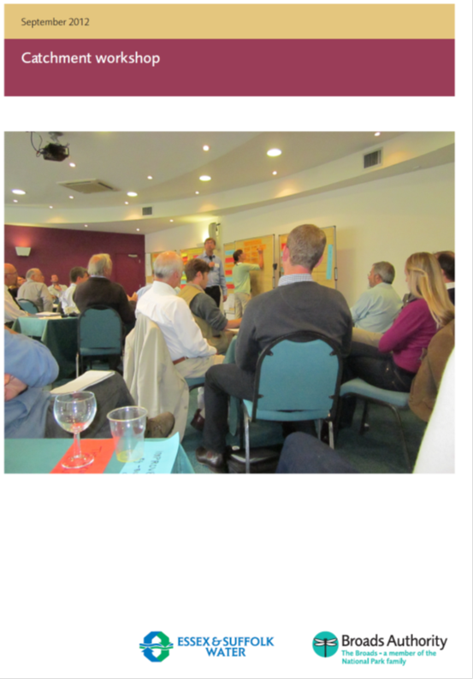
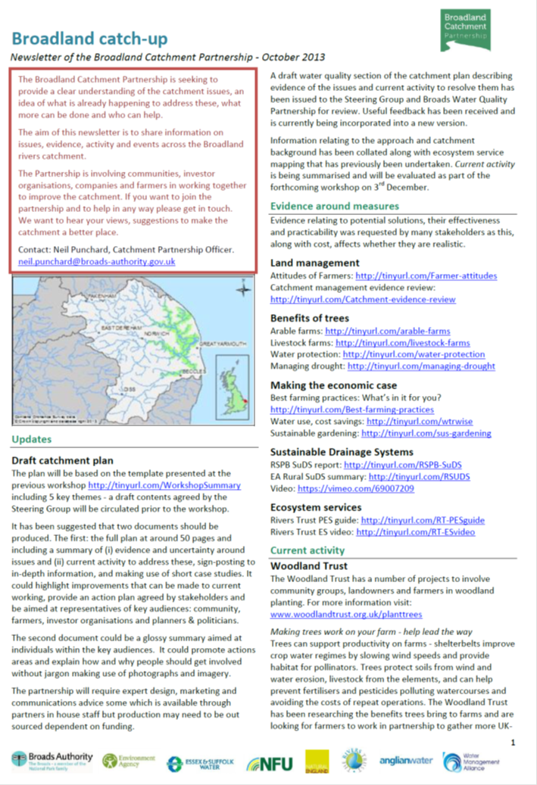
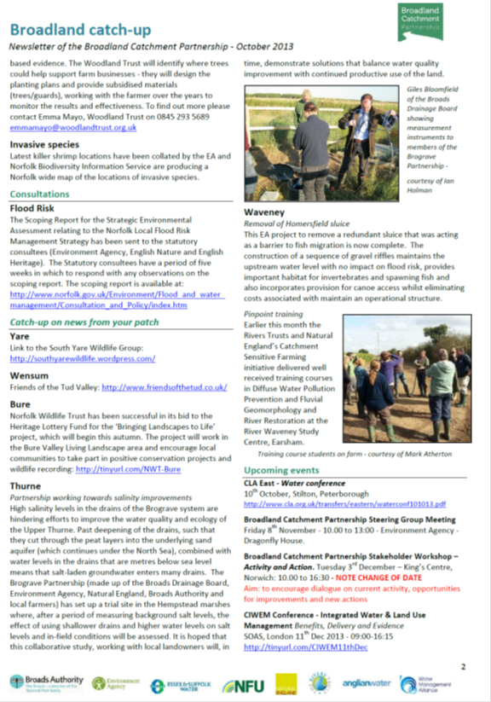
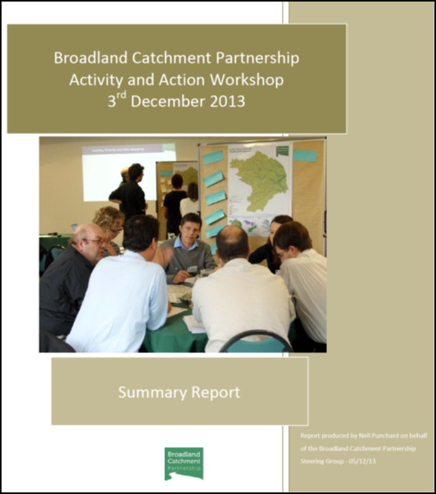
www.broads-authority.gov.uk/managing/broadland-catchment
Notes:
5 newsletters

Slide 20
Catchment Plan: Themes and Issues
Knowledge and understanding
Water quality
Water quantity
Habitat quality
Recreational access
Phosphorus
Sediment
Nitrogen
Pesticides
Integration of existing access
Incorporation into new schemes
Water availability
Flood risk
River and floodplain modification
Invasive species
Notes:
50 page document. Photographs, case studies, maps, 4 page summary sent to Parish Councils and communities via Bure Valley Living Landscapes, River Waveney Trust, wildlife groups. Farmers and landowners via NFU and CLA.

